Slide 1

S P R I N T - 1
24-06-2022 TO 30-06-2022

Slide 2

Title: Grofers(Online Grocery)
Url: https://www.grofers.com/
Team - 8
Team members: :
1. SWATHI CHINTAKUNTA
2. SWATHI DHAMODARAN
3. THRUPTHI P J
4. UMA MAHESWARI KATIKATALA
5. VIJAY M

Slide 3

GROFERS.COM :
"BLINKIT" is owned & managed by "Blink Commerce Private Limited” (formerly known as GROFERS India Private Limited)
Imagine needing something when you are at home and getting it before you have tied your shoelaces to step out. We are revolutionizing e-commerce by making the stuff most important to you, available to you in a blink of your eye

Slide 4
Outlet of the GROFERS.COM
Login
Search
My Account
View product
My Cart
Categories

Slide 5
Login :
1. Should login with mobile number
2. Receive OTP for correct credentials
3. Receive error message for incorrect credentials
4. Should be able to login on any browser
5. Should be able to login on any device
All team members

Slide 6
Search:
1. Auto suggestion
2. Search Result
3. Recent search data
4. Error message
5. Count of particular product
SWATHI DHAMODARAN

Slide 7
My Account :
1. User interface page
2. My profile
3. My orders to list
4. My wallet for transactions
5. Downloads
UMA MAHESHWARI KATIKATALA

Slide 8
View product:
1.
Click on Product card.
2.
Zoom the image of the product.
3.
View the product details.
4.
Check the separate scrollbar.
5.
Check the product Add to cart.
6. Category, Brands and Payment partners.
VIJAY M

Slide 9
My Cart :
1. Adding the product to cart
2. Remove the product from cart
3. Adding multiple product to cart
4. Adding multiple same product to cart
5. Checking the sequence of product
6. Applying coupon to product
THRUPTHI P J

Slide 10
Categories :
1.
Checking all products are categorized
5.
Total no of products under category
2.
View all products under category
6. Applying/ clearing filters
3.
Total no of filters applied
7.
Applying multiple filters
4.
Total no of products under filter
SWATHI CHINTAKUNTA

Slide 11
Function of the project :
Excel spread sheet :
User stories
Requirements
Test scenarios
Test cases
Defect report
Traceability matrix
Summary reports
JIRA :
Writing epic
Creating user stories
Executing test cases
Finding defects
Summary reports

Slide 12
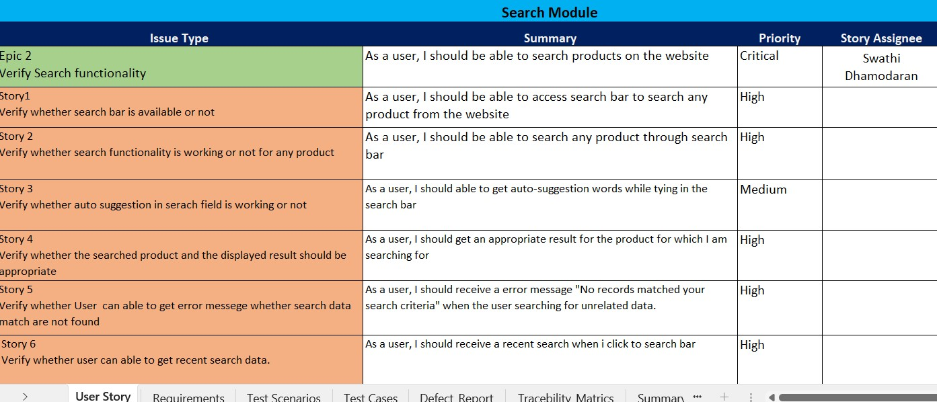
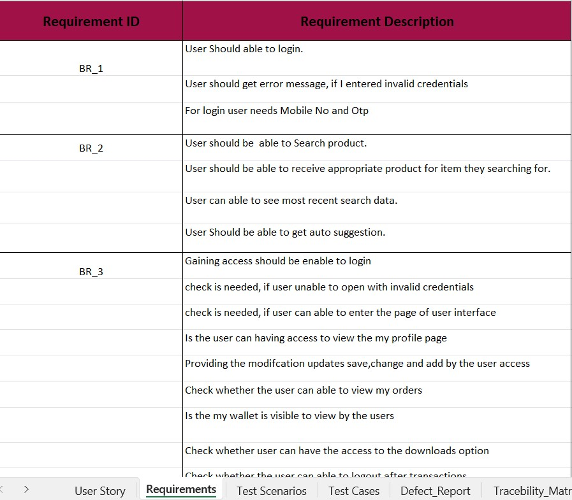
Working in Excel :
Creating epic under user stories followed by Issue type, summary, priority, Story assignee.
Creating requirements followed by Requirement Id, Requirement description.

Slide 13
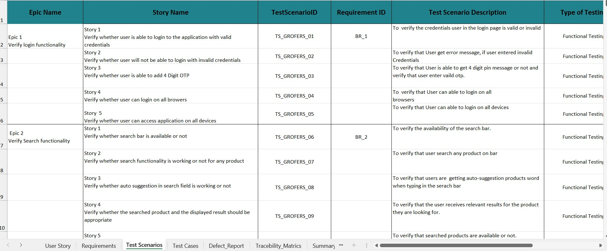
Writing test scenarios with type of testing, possible number of test cases:

Slide 14
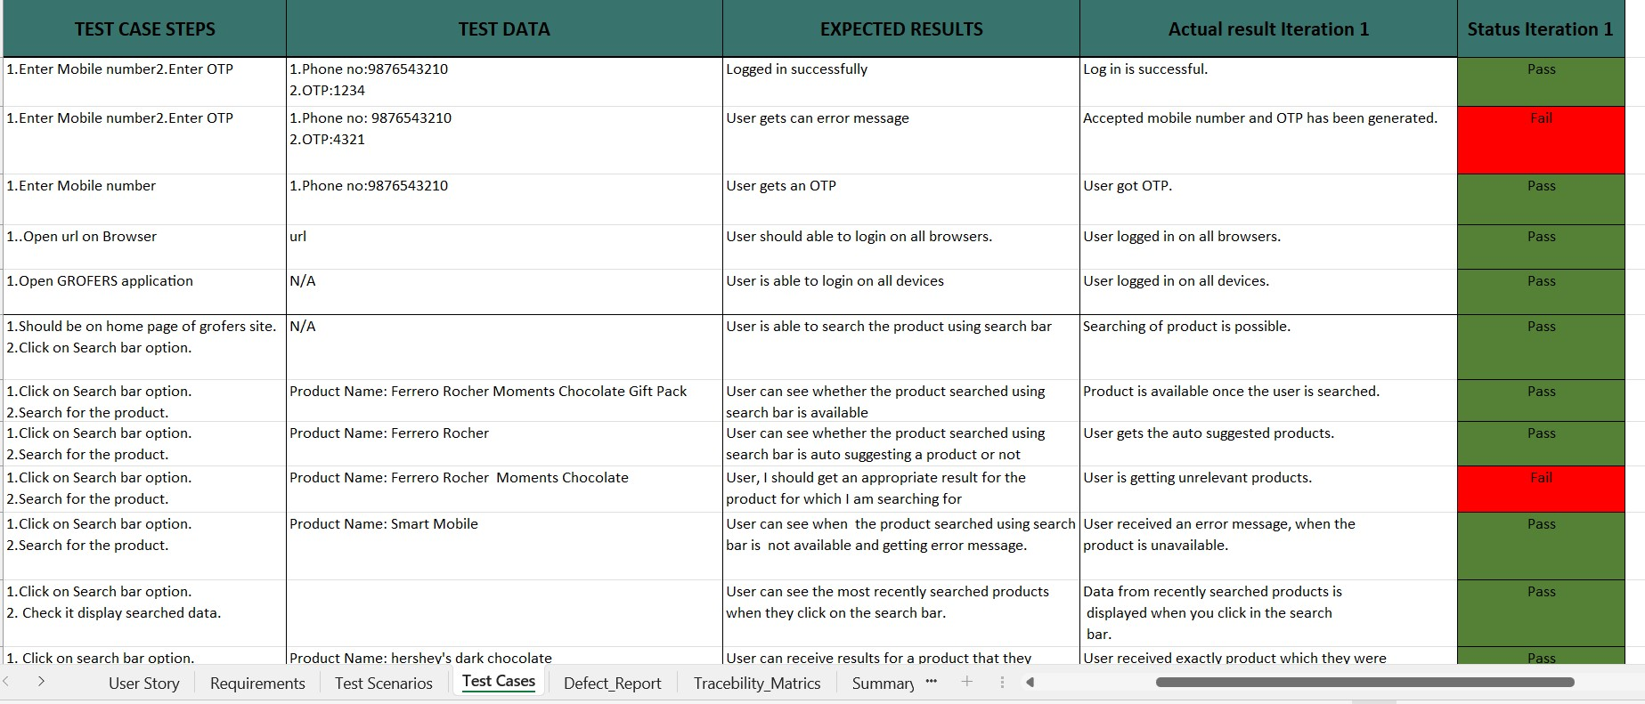
Writing test cases followed by Pre-condition, Test Condition, Expected results, status iteration:

Slide 15
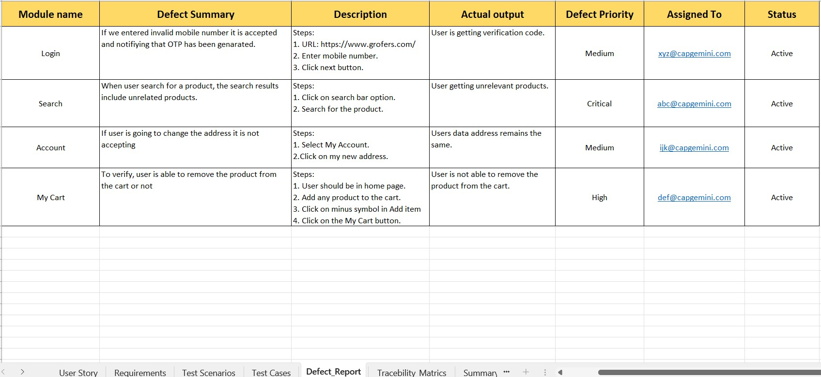
Finding defects followed by
Defect summary, actual output, defect priority, status:

Slide 16
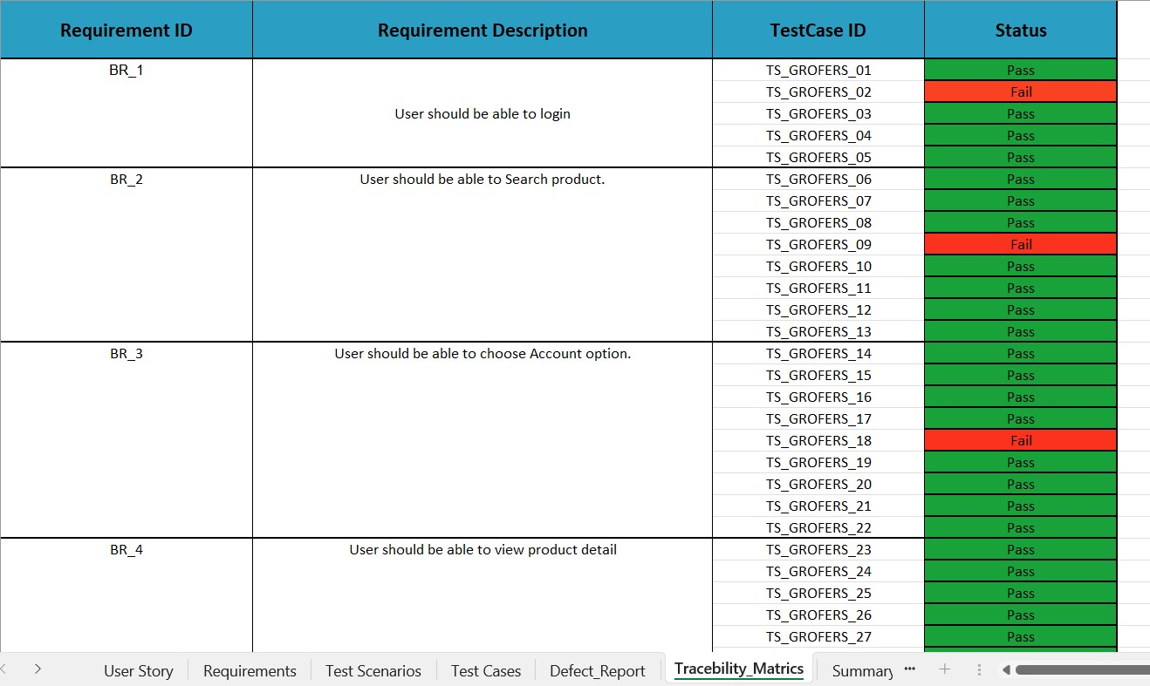
Traceability Matrix:

Slide 17

Working and executing on JIRA :
Jira Software can be configured to fit any type of project. Teams can start with a project template or create their own custom workflow. Jira issues, also known as tasks, track each piece of work that needs to pass through the workflow steps to completion.
USES :
Jira Software is part of a family of products designed to help teams of all types manage work. Originally, Jira was designed as a bug and issue tracker.

Slide 18

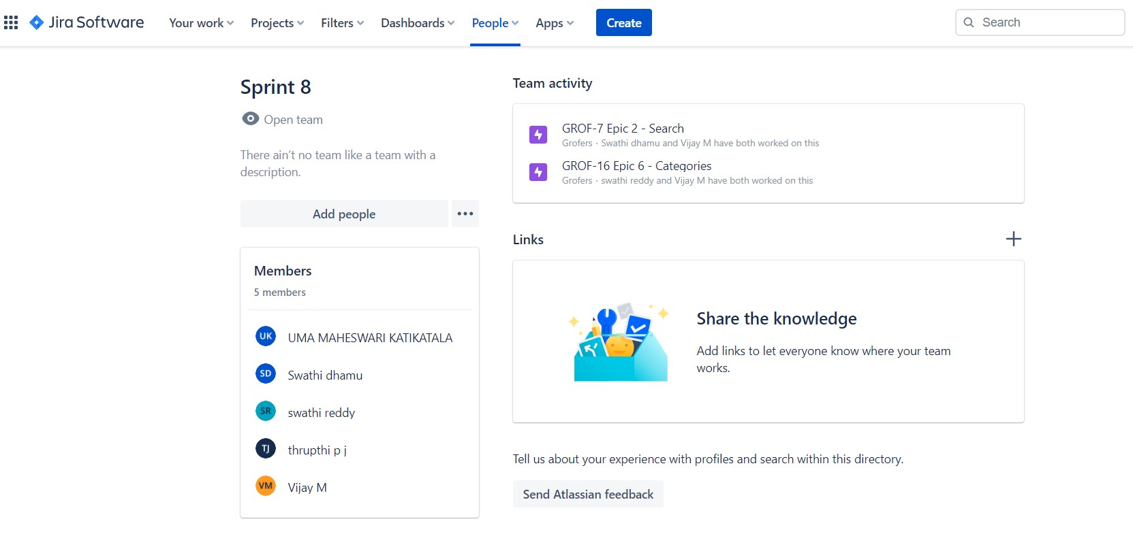
Creating team in JIRA:

Slide 19
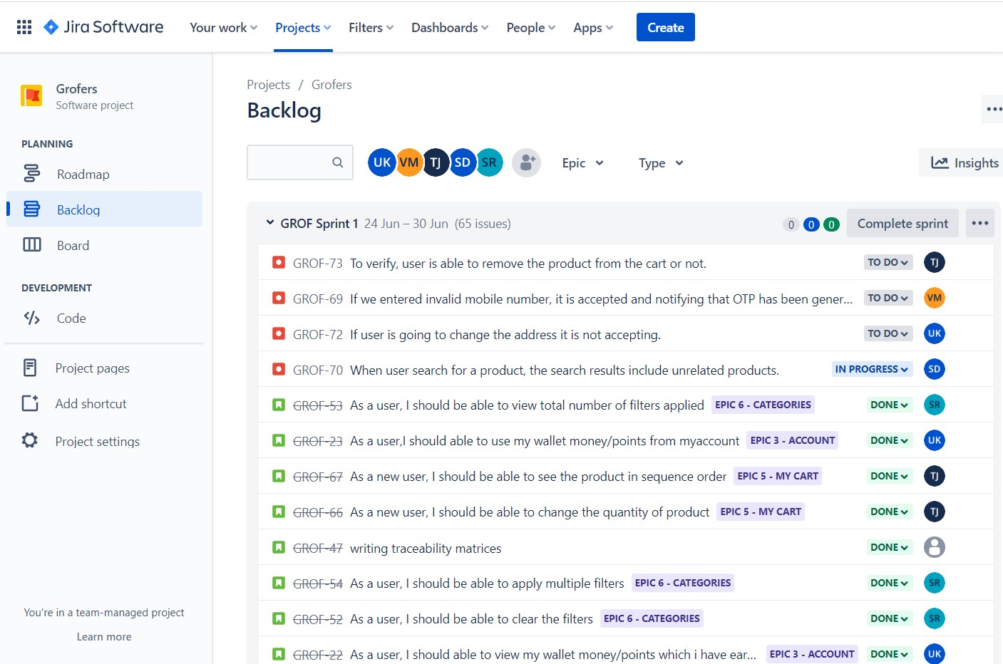
Creating issues in JIRA:
Entering user stories and epic in the software.

Slide 20
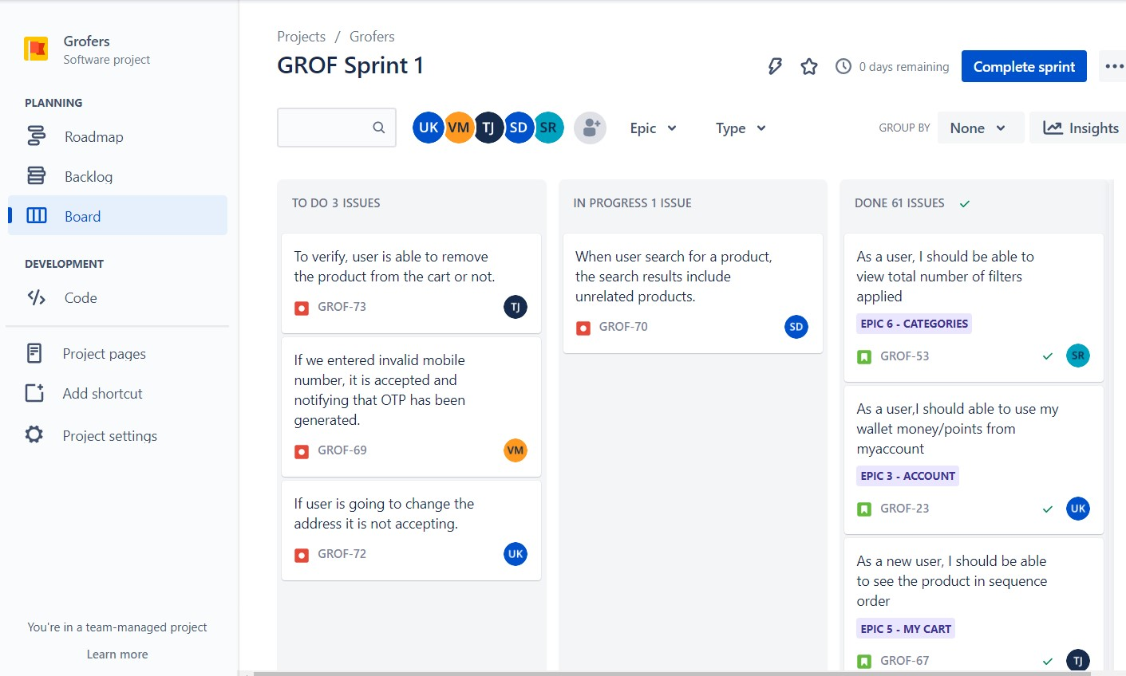
Placing the status of user stories in epic:
To do 2. In Progress 3. Done

Slide 21
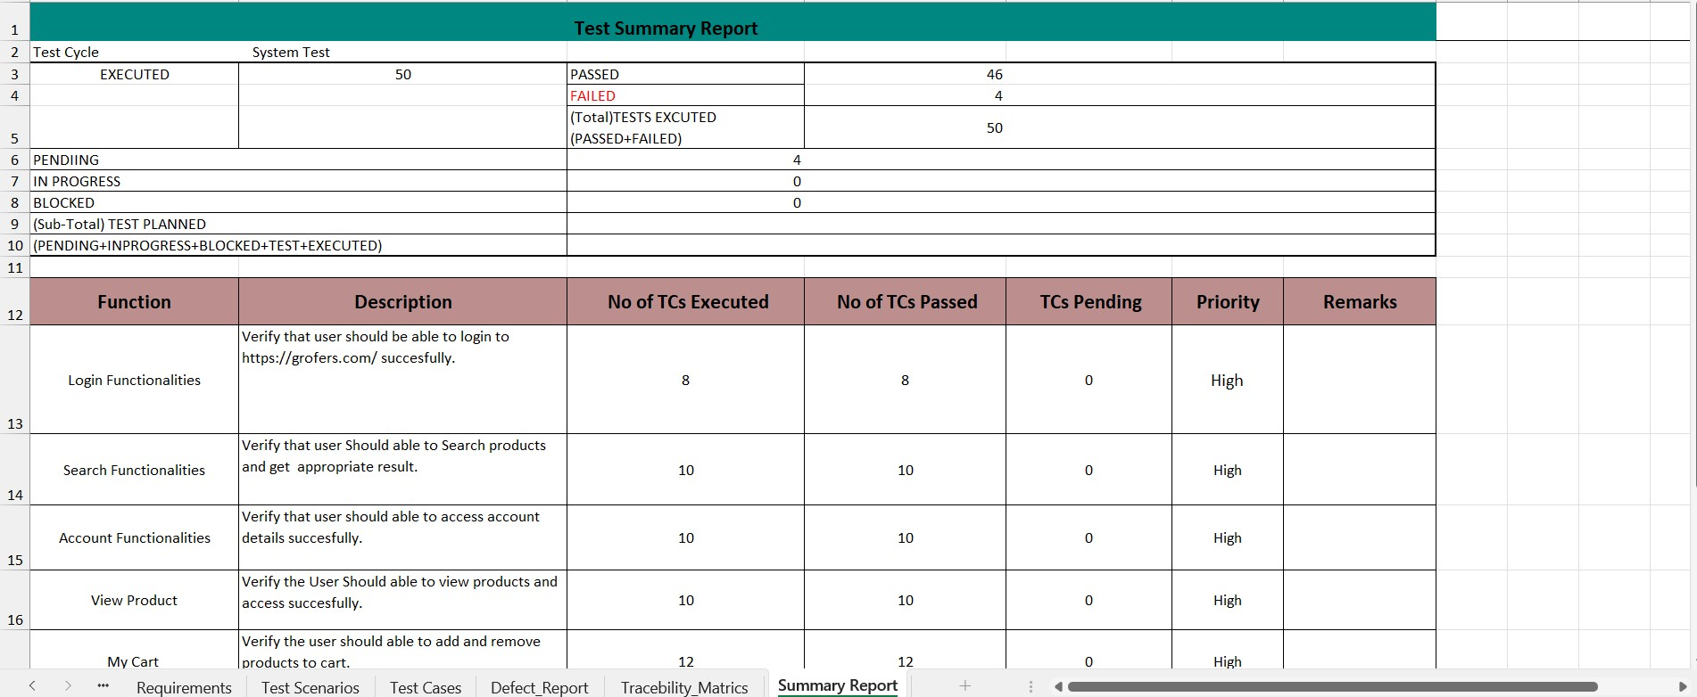
Summary Report :

Slide 22
Challenges faced :
1. Working with JIRA
2. Finding defects
How we overcome from the challenges :
We have overcome the above challenges with guidance of our good trainer and support of our wonderful teammates.

Slide 23

THANK YOU!

